Slide 1

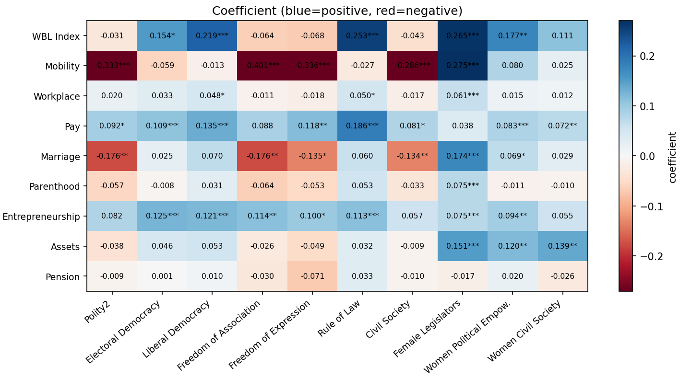
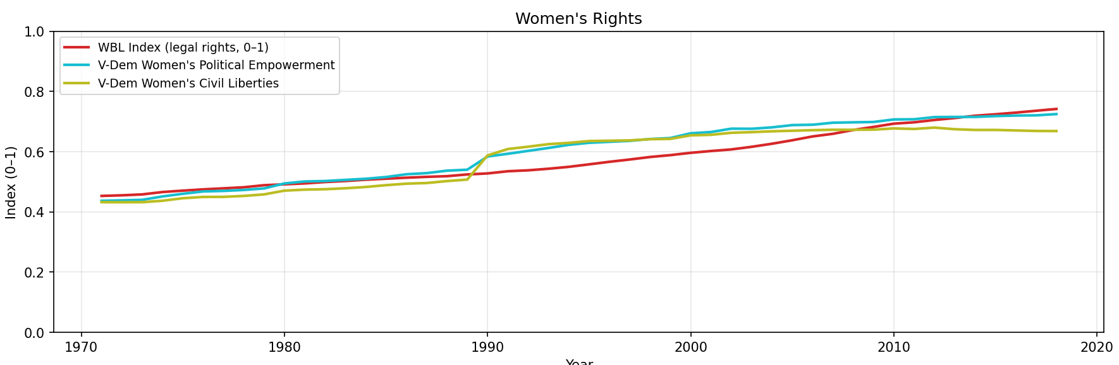
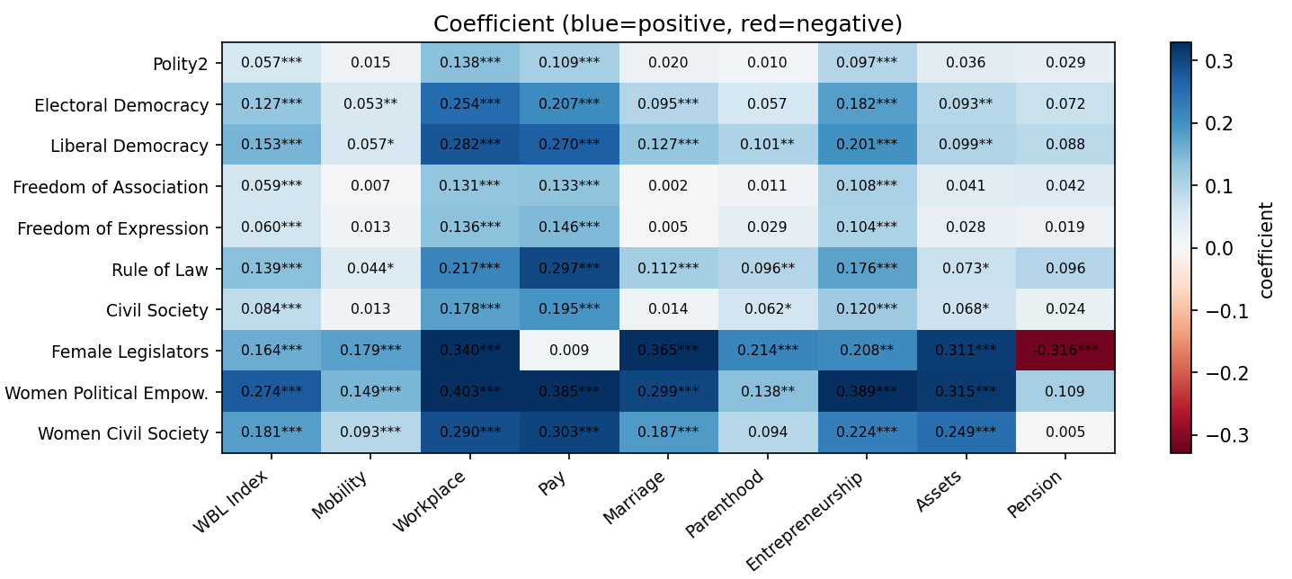

A Causal Analysis of the Relationship Between Democracy, Civil Liberties, and Women's Rights Under the Law
Damian Calabresi, Giacinto Paolo Saggese at University of Maryland, College Park
Motivation
Legal rights for women have expanded significantly since 1971, and so has democracy worldwide. At the same time multiple countries went through dissolutions, reunification, and democratization processes. Do these changes caused the improvements in women's legal rights? Does the effort of civil and women rights organizations make an impact?
Behr et al. (2024, World Bank) establishes a strong correlation between democracy and gender equality but explicitly stops short of a causal analysis.
Research Questions
Do changes in democracy and civil freedom predict improvements in women's legal rights?
Is the reverse also true? Do legal reforms for women precede increase in democratic levels?
Are civil liberties and civil organizations as important as democracy?
Data
Panel
174 countries
48 years (1971–2018)
8,561 country-year observations
Methods
Granger Causality Testing: applied country-by-country on first-differenced series (to ensure stationarity). Lags 1–4 years tested; results summarized by minimum p-value per country.
Panel Fixed Effects Regression: Granger causality establishes temporal precedence, but cannot rule out confounding from time-invariant country characteristics (legal tradition, colonial history, geography). Panel FE regression addresses this by absorbing those confounders.
Forward Direction: Democracy -> Women's Rights
Workplace, Pay, and Entrepreneurship show the strongest and most consistent effects. Pension is the least responsive off all WBL categories. All coefficients point in the same direction: more democracy and women's representation precede stronger legal rights.
Reverse Direction: Women's Rights -> Democracy
The reverse signals are consistently and substantially weaker overall. Workplace shows the most extreme asymmetry: 100% significant forward and only 10% reverse. Pension shows 0% reverse significance. The exception is Mobility, where 50% of reverse regressions are significant but with a negative coefficient (-0.107)
Key Findings
Female Legislators is the strongest single predictor overall, predicting an improvement in marriage law and parenthood rights
Rule of Law is the strongest institutional predictor for Pay and the overall WBL Index
Workplace, Pay, and Entrepreneurship are the most consistently predicted outcomes. Pension is the least responsive
Religion moderates signal strength but not direction. Mobility coefficient is negative in Muslim-majority countries
Conclusion This study provides temporal, country-level evidence that democratic institutions and civil liberties improvements lead to gains in women's legal rights. Policies aimed at strengthening democratic institutions and promoting civil society organizations may be among the most effective levers for advancing legal gender equality globally.
Dataset | Coverage | Role
Polity5 | 195 polities, 1776–2018 | Democracy scores
V-Dem v16 | 202 polities, 1789–2025 | Civil liberties indices
World Bank WBL | 190 economies, 1971–2024 | Women's legal rights (outcome)
Pew RDI | 230 countries, 2010 | Religious composition (control)

